Slide 1

Supervised Learning capstone
TV Broadcast Segments – Which Ones are Commercials?
Stu Alden Thinkful Data Science Flex Course

Slide 2
Background
We all dislike television commercials. On pre-recorded material, would save time if commercials could be cut-out automatically.
Given sufficient data describing commercial and non-commercial segments of broadcast, seems plausible that an algorithm could distinguish between the two.
Since I’m not familiar with the ways that audio and video data can be captured, I looked for a pre-existing data set to which I could apply the algorithms we’ve learned so far.

Slide 3
Data and research found online
In the UCI Machine learning repository (https://archive.ics.uci.edu/ml/datasets.php) a dataset published in 2015 by (hereafter referred to as “the authors”) Dr. Prithwijit Guha , Raghvendra D. Kannao and Ravishankar Soni from the Multimedia Analytics Lab, Department of Electrical and Electronics Engineering, Indian Institute of Technology, Guwahati, India
Found additional information in related paper online, by Guha/Kannao (above) plus Apoorv Vyas and Vineet Bhargava: “Commercial Block Detection in Broadcast News Videos,” in Proc. Ninth Indian Conference on Computer Vision, Graphics and Image Processing, Dec. 2014
Details of machine learning algorithms not provided, but R-squared scores of 95% were reported using an SVM approach. With additional “post-processing” (avoiding unrealistically long stretches of commercials or non-commercials), scores were raised to 97%.
I took 97% R-squared as my “stretch goal”

Slide 4
Data Highlights
About 30 hours of news broadcasts recorded from each of three Indian TV stations and two international news stations (BBC and CNN)
I chose to restrict my analysis to BBC and CNN
Data is relatively “balanced,” with commercial time comprising 25-30% of total air-time
Data was not broadcast recording itself, but derived statistics stored on a per-segment basis (segment being a stretch of either news or commercials). Some examples of the statistics:
Duration of the segment (in frames – 1/30 of a second)
For video:
Distribution of text in bands across screen (commercials tend to have a different “look”)
Edge change ratio (commercial images tend to change more quickly)
For audio:
Fundamental frequency – helps differentiate music (more common in commercials) from speech
Mel-frequency cepstrum coefficients (MFCC) summarized in a “bag of words” format – useful for speech recognition

Slide 5
Data Highlights (cont.)
Key aspects of the file structure:
One segment per record; each record containing up to 4125 fields
Each segment marked as news (-1) or a commercial (1)
113 video information fields, up to 4012 audio fields
Data stored in sparse row matrix format (scipy.sparse.csr_matrix) since so many fields are zeros. Fortunately, the sklearn routines handle this format without issues.
Data quality
In general, data appeared clean, and no adjustments were made
Only two issues noted:
Tallying total length of all segments, BBC was 21 hours and CNN was 26 hours of programming, versus the ~30 quoted by the authors.
The authors describe content of each field, but numbering system does not line up with description:
For example, they say fields 18 – 58 inclusive( a total of 41 fields) is for 40 bins. So, there is some ambiguity in the field definitions.
I opted to regularize the data (with StandardScaler) as it significantly improved performance of non-tree models. (For example, required iterations for logistic regression were reduced by a factor of 30!)

Slide 6
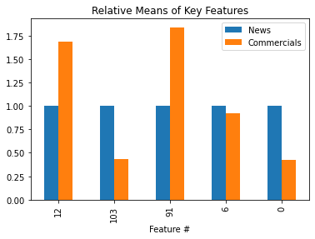
Some Exploratory Data Analysis
Top features from gradient boosting model showed some marked differences, news vs. commercials. Here is a graph of the relative means (setting news means to 1.0) of the top 5 features:
Of these top features, #0 (the 5th most important) is shot length (number of 1/30th second video frames).

Slide 7
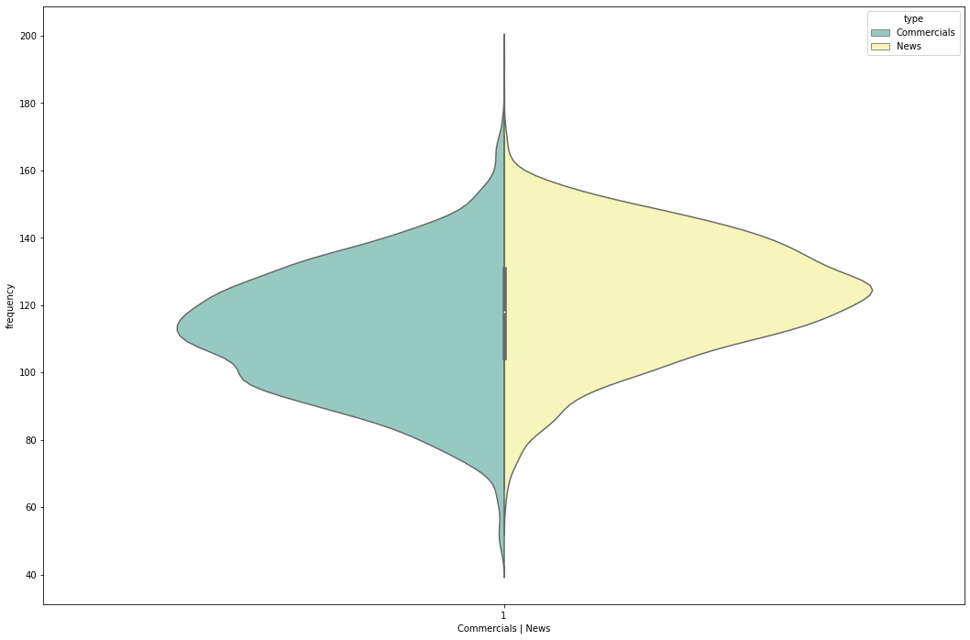
Some EDA (cont.)
Authors commented that fundamental frequency (lowest pitch) of audio should be significantly different, news vs. commercials (commercials being more likely to have music). However, there is significant overlap (see violin plot below). Accordingly, fundamental frequency was not a top feature in the models I tried.

Slide 8
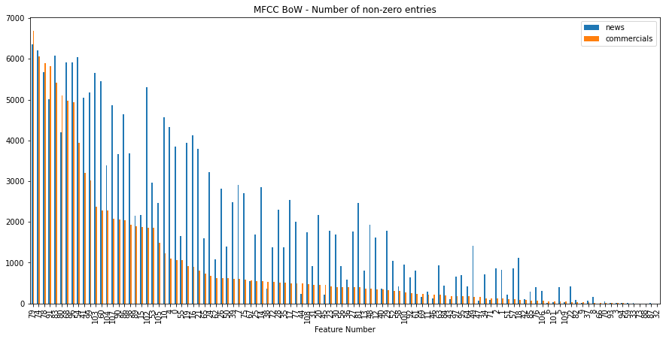
Some EDA (cont.)
The MFCC Bag of Words encoding used only 110 of the potential 4,000 features. Across these 110 features, though, the pattern was significantly different, news vs. commercials:

Slide 9
Modeling Tools Used
Evaluated each of the supervised learning classifier models we've learned about so far:
Logistic Regression
K-Nearest Neighbors
Support Vector Machine
Single Decision Tree
Random Forest
Gradient Boosting using shallow trees
Using the sklearn routines, including GridSearchCV to cross-validate using variety of parameters, I trained models on subset of BBC data, trying to achieve highest possible R-squared score
Then applied models to test subset (distinct from training data) to check for overfitting.
Finally, used models (both as-is and retrained) on CNN dataset to examine differences in performance.

Slide 10
Results for BBC International News
Model | Key Parameters | R-squared (train) | R-squared (test) | Run Time (sec)
KNN | 11 neighbors, uniform wgt | 85.7% | 82.9% | 42
Logistic Regr. | 422 iterations, L2 | 86.1% | 85.8% | 4
Linear SVC | 440 iterations, L2 | 86.0% | 85.9% | 25
Decision Tree | gini, max depth 8 | 90.0% | 85.0% | 3
Grad. Boost | 300 estim, max depth 4 | 93.0% | 88.8% | 226
Random Forest | 100 estim, max depth 11 | 94.9% | 88.3% | 68
Although authors reported best results using SVM, the tree-based models were better for me
Run times varied greatly; single decision tree provided good performance with very short run time
The authors’ final “post-processing” could not be replicated; records are clearly not in broadcast order (1st 300 segments were commercials)

Slide 11
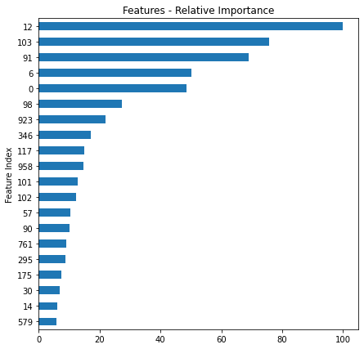
Feature Importance – Gradient Boosting
Feature list for single decision tree is similar (but not identical)
Different from top list described by authors of the paper:
They cited primarily text band and the MFCC BoW features.
My top five were:
Spectral rolloff variance
Text area mean (7th of 15 measurements)
Text area mean (1st of 15 measurements)
Short-time energy variance
Shot length (number of video frames)
For me, top BoW feature is only#7; fundamental frequency mean is down at #19

Slide 12
Comparison between BBC and CNN
R-squared
Trained On | BBC Train | BBC Train | CNN Train | CNN Train
Applied To | BBC Test | CNN All | CNN Train | CNN Test
Decision Tree | 85.0% | 60.5% | 93.3% | 90.2%
Gradient Boost | 88.8% | 68.9% | 97.8% | 94.2%
Random Forest | 88.3% | 63.9% | 98.5% | 93.4%
Performance of the BBC-trained model is poor when applied to CNN data
Suggests “look and feel” or “style” of TV channel is key driver of model
When model “retrained” on larger CNN data (same parameters), performance even better than with BBC data set.

Slide 13
Summary
My models do reasonably good job of discerning between news and commercials, given the data sets I examined
Of course, “heavy lifting” of feature preparation was already done for me
Not sure whether, say, 90% or 95% accuracy is “good enough.”
False positive (blocking a non-commercial) possibly worse than false negative (not blocking a commercial).
If 90% is sufficient, then single decision tree model is best choice, given its excellent speed. If 93%+ is needed, random forest is best choice, albeit with a significant performance penalty.
It appears that results almost as good could be achieved on much smaller feature set
However, may be harder to distinguish commercials from general TV shows (rather than just news)

Slide 14
Summary (cont.)
Items for future research:
Learn how to capture video content coming into my home
Find or build Python tools to encode the video and audio statistics that provide the most useful features
All notes and analysis (including this presentation) are in a shared Google Drive folder (this is “v(ersion) 3”):
https://drive.google.com/drive/folders/1t0ONgVtl-DB664LDsPtrSqFfWn229IBO?usp=sharing

